Slide 1


SMART INDIA HACKATHON 2026
CRYPTOTRACE — BLOCKCHAIN FORENSICS & TRANSACTION INTELLIGENCE
• Problem Statement ID - SIH26183
• Problem Statement Title - Real-Time Identification of Fraud-Linked Cryptocurrency Exchanges from Victim-Reported Suspect Wallet Addresses through Automated Blockchain Analytics
• Ministry / Organization - Ministry of Home Affairs (MHA) / Indian Cyber Crime Coordination Centre (I4C) / NCRP 1930
• Theme - Blockchain & Cybersecurity
• PS Category - Software
• Team ID - SIH26183-BB
• Team Name - Byte Builders

Slide 2
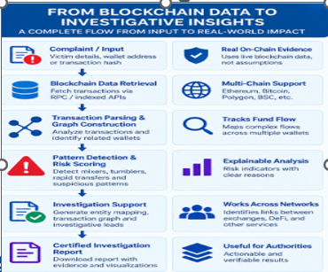
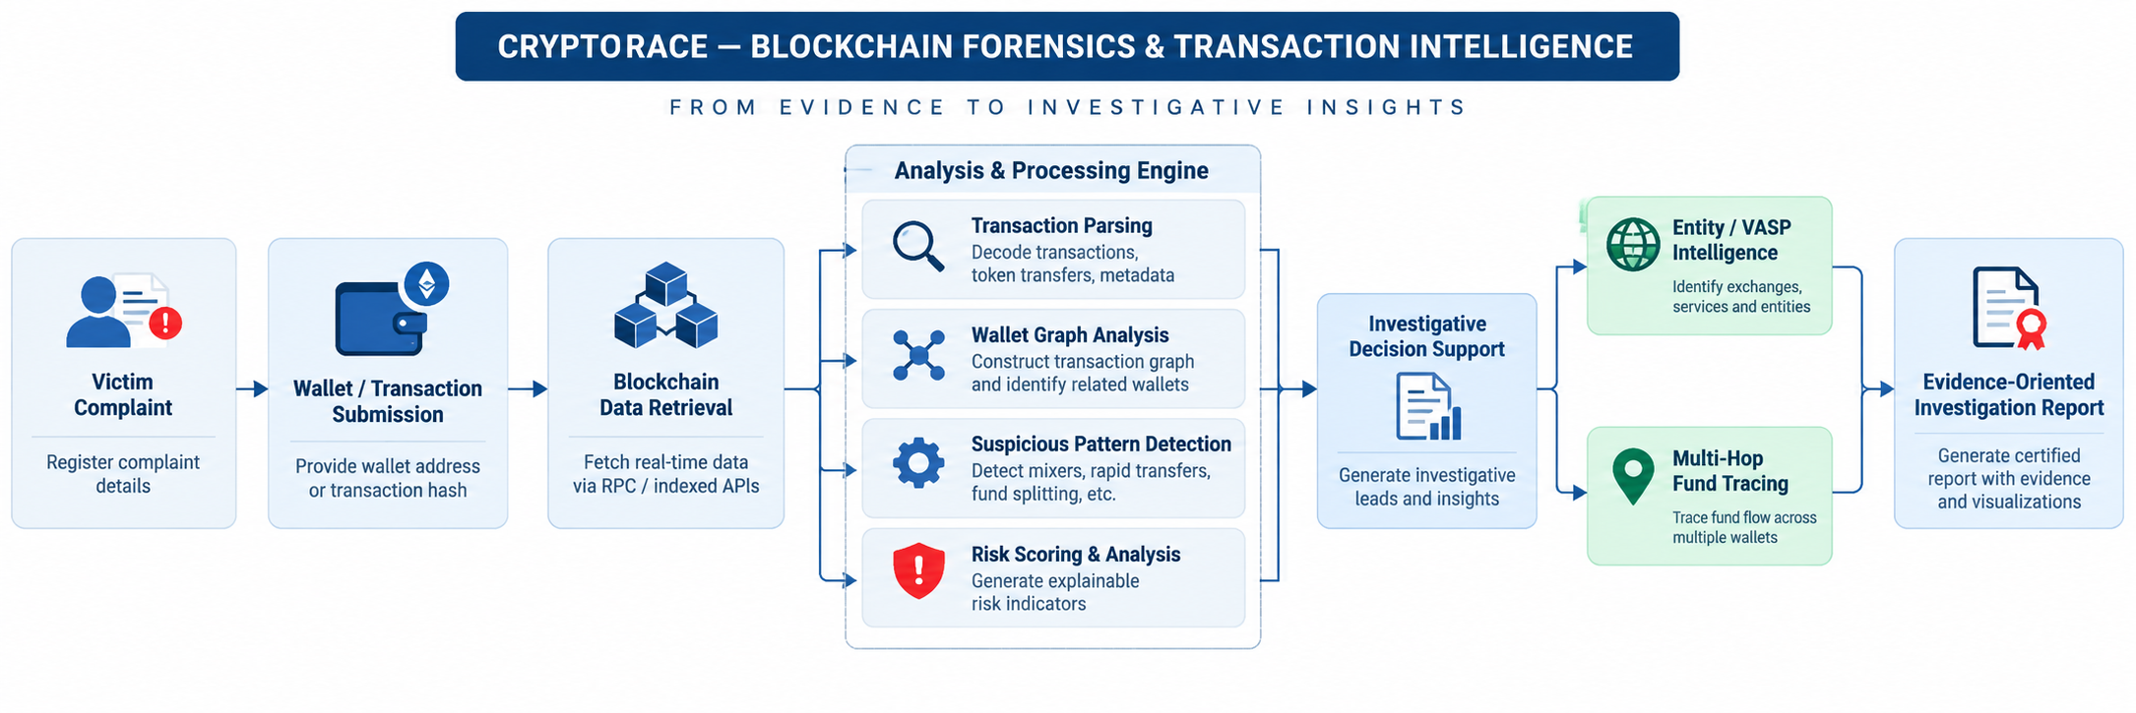
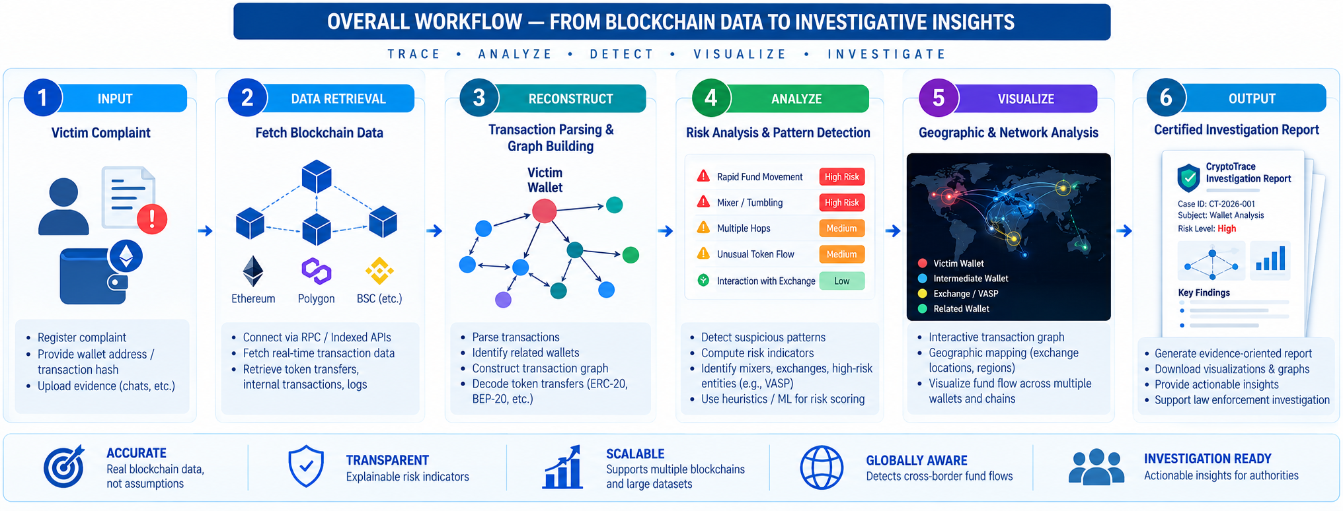
Byte
Builders
CRYPTOTRACE — BLOCKCHAIN FORENSICS & TRANSACTION INTELLIGENCE
@SIH Idea submission- Template
@SIH Idea submission- Template

Slide 3
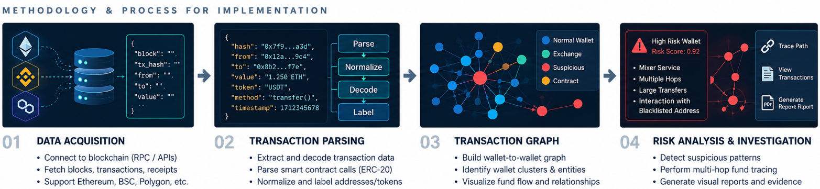
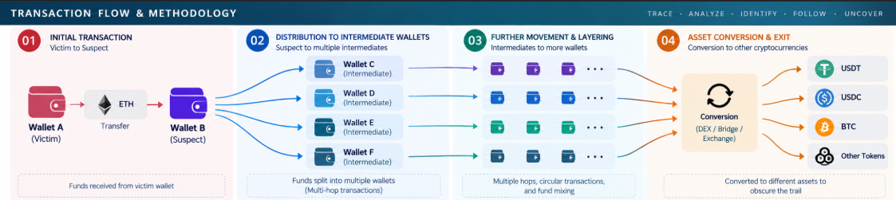
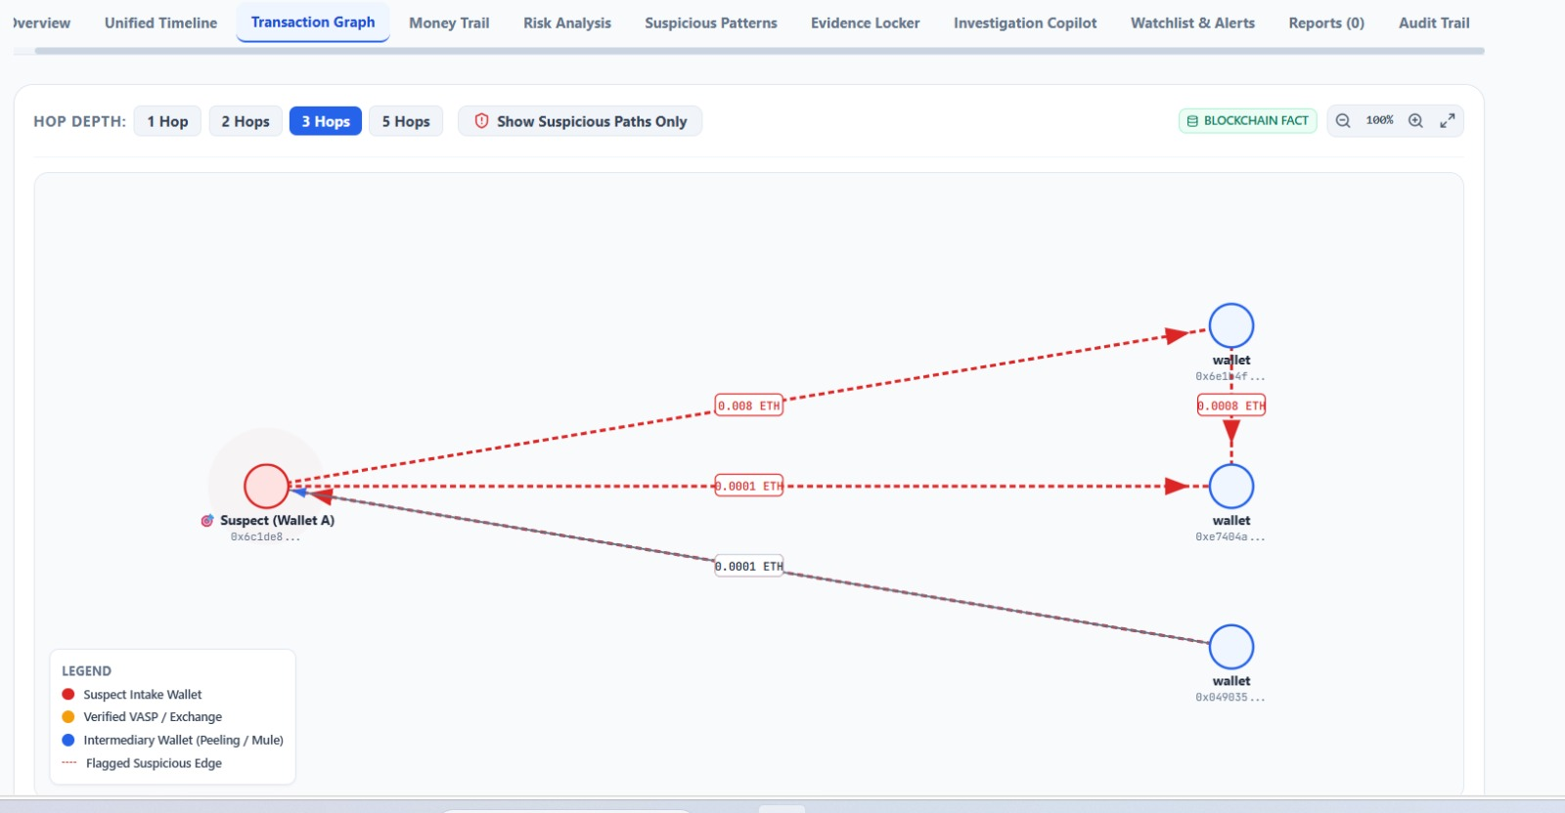
TECHNICAL APPROACH
Byte
Builders
TECHNOLOGIES TO BE USED
A I / M L
Python 3.12
NetworkX
Scikit-Learn
NumPy & Pandas
BLOCKCHAIN & WEB3
Web3.py
Etherscan Developer API
Ethereum / Sepolia Testnet Nodes
CERTUS- S 2
FORENSICS & TRUST
SHA-256 Cryptographic Hash Engine
ReportLab PDF Engine
BSA Sec 63 / Sec 65B Compliance Locker
FATF Rec 15/16 VASP Mapping Registry
APPLICATION & FRONTEND
React 18 + TypeScript
Cytoscape.js
WORKING PROTOTYPE
Tailwind CSS + Lucide Icons + Vite
BACKEND & INFRASTRUCTURE
FastAPI
SQLAlchemy ORM
Supabase / PostgreSQL / SQLite Fallback
Docker & Render Cloud Deployment

Slide 4
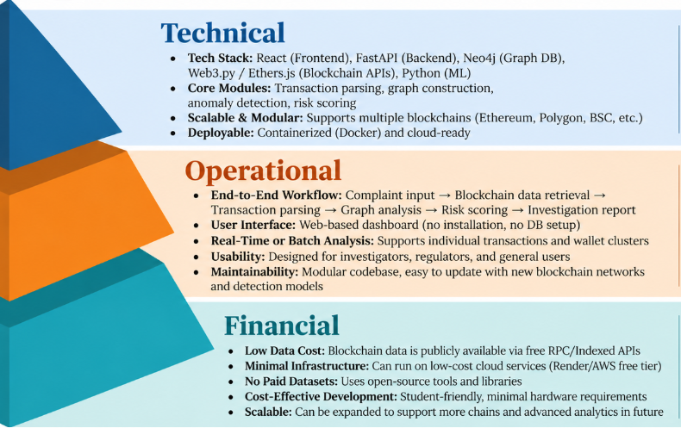
FEASIBILITY AND VIABILITY
Byte
Builders
PHASED ROADMAP
Phase 1
1
Blockchain Data Foundation
Phase 1: Blockchain Data Foundation — Real-time Web3.py RPC & Etherscan API data ingestion, EIP-55 wallet validation, token-transfer parsing establishing core forensic data pipeline.
Multi-Hop Transaction Intelligence
Phase 2
2
Phase 2: Multi-Hop Transaction Intelligence — NetworkX graph-based fund-flow reconstruction, 1-to-5 hop BFS tracing, 11-rule deterministic risk scoring, peeling chain & fan-out detection.
Forensic Investigation Platform
Phase 3
3
Phase 3: Forensic Investigation Platform — Interactive Cytoscape.js transaction graphs, automated VASP entity attribution, SHA-256 evidence locker, BSA Sec 63 ReportLab PDF dossier export.
Phase 4
4
Continuous Monitoring & Scalable Deployment
Phase 4: Continuous Monitoring & Scalable Deployment — Real-time NCRP 1930 webhooks, automated Section 91 CrPC subpoena priority ranker, multi-chain expansion, and Render cloud deployment.

Slide 5
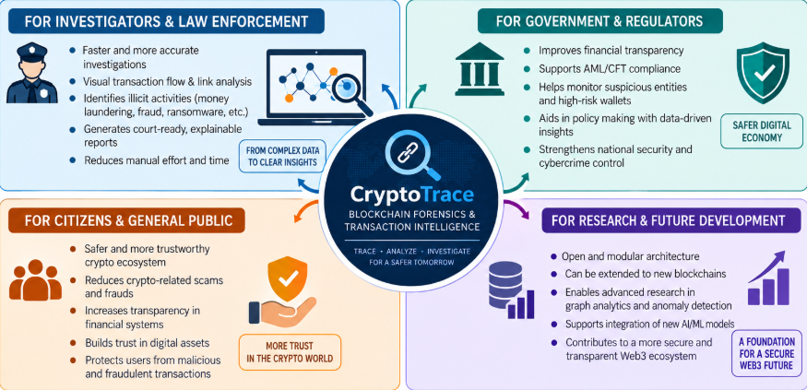
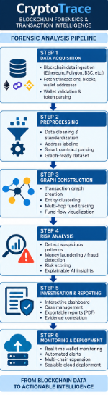
Byte
Builders
IMPACT AND BENEFITS

Slide 6
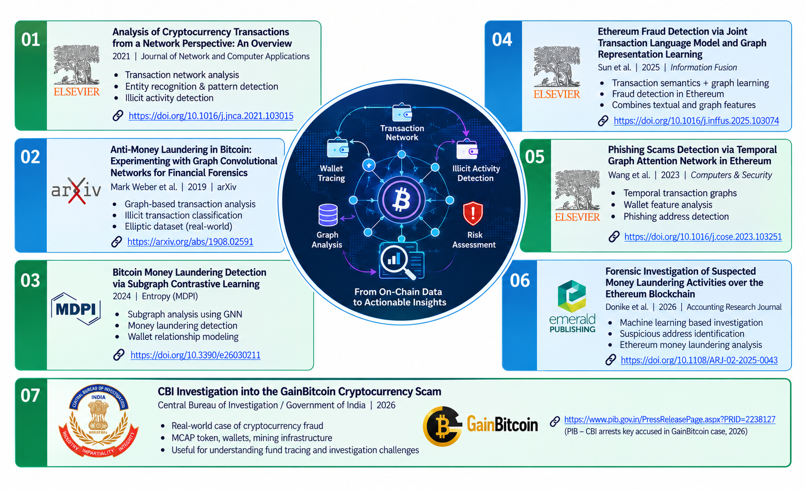
RESEARCH AND REFERENCES
Byte
Builders
6

